Slide 1
Principles of Management
1st Internal 2018

Slide 2
Overview of Management
Definition of Management
Management is the attainment of organizational goals in an effective and efficient manner through planning, organizing, staffing, directing and controlling organizational resources.
Organizational resources include men, machines materials, money.
The process of reaching organizational goals efficiently and effectively by working with and through people and other organizational resources.
Goals may be to create surplus.
Management is concerned with “Doing the right things right at all times”:
Notes:
Management is concerned with “Doing the right things right at all times”:
Effectiveness: Achievement of objectives (Right Things);
Efficiency: Achieving those objectives with least amount/ sacrifice of resources (Things Right);
Continuous Improvement: in creating increasing ‘surplus’ (at all times);
“Improve or die” = survival of the fittest
“what gets measured, gets managed and improved” e.g. Productivity= Output / Input ratio
“Management is the process of designing and maintaining an environment in which individuals, working together in groups, efficiently accomplish selected aim(s) viz. to create a surplus(s).” …. Weihrich & Koontz

Slide 3
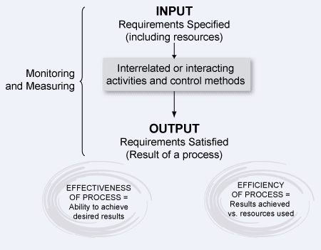

Slide 4
Definition of Management Gurus speak
The use of people and other resources to accomplish objectives - Louis E Boone & David L Kurtz-.
The act of getting things done through people - Mary Parker Follet.
Management as the art of knowing what you want to do in the best and cheapest way - Frederick Taylor.

Slide 5
History of Management Development
Developed gradually through centuries to its present formidable state.
Theories & approaches
The Classical approach
Human Resource Approach
The Modern approach

Slide 6
Classical Approach
The Classical Perspective to management emerged during the nineteenth century and continued till the twentieth century.
Due to new challenges the organizations faced management sought methods of efficiency which included a rational and scientific approach

Slide 7
The Classical Approaches
The classical approach includes the following three theories and their contributors:-
Scientific Management by Frederick Taylor
Administrative Principle by Henry Fayol
Bureaucratic Organization by Max Weber

Slide 8
Scientific Management by Frederick W Taylor
Scientific Management or Taylorism was a scientific method which was used to optimize the way in which tasks were performed thus improving the labor productivity.
One of Taylor’s philosophy was
“In the past man must has been first. In the future system must be first”.

Slide 9
F.W. Taylor
Founder Father of Scientific Management
Focus is higher Productivity by better utilization of workers.
Introduced Management responsibility is to
1. Identify elements of man’s work
2. Each work should be assigned to a workman and to train them, instead of leaving to the workmen to choose.
3.Manufacturing Process should be designed by Management in a scientific way and accepted by the workman.
4. Management and Workman responsibility are to be well defined and spelt out for the work.

Slide 10
5 Functions of Management Process
as defined by Henry Fayol
Henry Fayol has identified the following 5 functions of management.
Planning
+ Organizing
+ Staffing
+ Leading
+ Controlling
to accomplish certain pre-determined, (as derived from stakeholder needs) goals or objectives

Slide 11
Human Resource Approach
Motivation

Slide 12
Human Behavior management
Elton Mayo-Father of Human Relation approach.
Based on Hawthorne Studies he established –
Organization not merely a formal structure but a live and dynamic social system.
Feeling of a member of a Team and a sense of participation is a greater motivating force than improving working condition
Efficiency depends on mental condition and his relation with his superiors and colleagues
A common psychological bond that exists among the members of the group influence the conduct of the group.
Emotions , including prejudices play a major role in shaping the behavior of the group.
Group behavior overrides individuals
Human and social incentives are greater influence than financial.

Slide 13
Maslow’s Theory of Human’s Needs
Maslow’s hierarchy of needs is a theory of psychology that contends each one of us is motivated by needs.
Maslow’s Needs states that we must satisfy each need in order, starting with the first, which deals with the most obvious needs of survival, food and shelter first.
Only when the lower order needs of physical requirements are met, people looks forward to satisfy the emotional needs, which fulfills the esteem and self-actualization needs..

Slide 14
Maslow’s Hierarchy of Needs
Self –Actualization Personal Growth & Fulfillment
Esteem Needs Achievement, Status, Responsibility, Reputation
Belongingness and Love needs Family, Affection, Groups, etc.
Safety Needs Protection, Security, Law & Order, Stability etc.
Biological and Physiological Needs Food, Water, Shelter, etc.

Slide 15
Needs
Maslow’s Theory states that
Needs must be satisfied in the given order . It moves from Level 1 to 5; once the lower one is met, it shifts to higher order.
Levels 1 to 4 is Deficiency Need (motivator) and Level 5 is a Growth Need (motivator)
Examples he used as
You cant motivate to achieve their sales target (level 4) when they are having problems in their marriage
You cant expect someone to work effectively as a Team member(level3) when they are having their house re-possessed i.e. security problem(level2)

Slide 16
Needs in Social and Occupational perspective
Personal/Social Needs | Need Hierarchy | Occupational Needs
Personal Growth, Fulfillment | Self Actualization | Advancement
Approval, Achievement | Esteem Needs | Recognition, High status
Family, Friends, Community | Belongingness & Love Needs | Coworkers, Groups, & Clients
Protection, Law, Freedom | Safety Needs | Benefits, Stability, Occupational Safety
Food, Air Water, Sleep | Biological & Physical Needs | Proper Temperature, Air, Basic Salary

Slide 17
ERG Theory.
In 1969, Clayton Alderfer's revision of Abraham Maslow’s Hierarchy of Needs, called the ERG Theory.
ERG theory
Existence,
Relatedness
and Growth
and was created to align Maslow's motivation theory more closely with empirical research.

Slide 18
Differences from Maslow's Needs Hierarchy
Alderfers ERG theory demonstrates that
More than one need may motivate at the same time.
A lower motivator need not be substantially satisfied before one can move onto higher motivators.

Slide 19
Differences
The ERG theory also accounts for differences in need preferences between cultures better than Maslow's Need Hierarchy;
The order of needs can be different for different people.
It can explain the "starving artist" who may place growth needs above those of existence.

Slide 20
Differences
The ERG theory acknowledges that if a higher-order need is frustrated, an individual may regress to increase the satisfaction of a lower-order need which appears easier to satisfy.
This is known as the frustration-regression principle.

Slide 21
Herzberg's theory of motivators and hygiene factors
Herzberg (1959) constructed a two-dimensional paradigm of factors affecting people's attitudes about work.
He concluded that such factors as company policy, supervision, interpersonal relations, working conditions, and salary are hygiene factors rather than motivators.

Slide 22
Herzberg
According to the theory, the absence of hygiene factors can create job dissatisfaction, but their presence does not motivate or create satisfaction.

Slide 23
Herzberg’s Motivators
The motivators were elements that enriched a person's job;
He found five factors in particular that were strong determiners of job satisfaction:
achievement,
recognition,
the work itself,
responsibility,
and advancement.

Slide 24
Herzberg
These motivators (satisfiers) were associated with
long-term positive effects in job performance
The hygiene factors (dis-satisfiers) consistently produced
only short-term changes in job attitudes and performance, which quickly fell back to its previous level.

Slide 25
Theory X and theory Y
Theory X and Theory Y are theories of human motivation created and developed by Douglas McGregor at the MIT Sloan School of Management in the 1960s

Slide 26
Theory X and Theory Y
Theory X | Theory Y
The average individual dislikes work and will avoid it whenever there is opportunity | The average individual likes to work and it’s a natural activity
Most people must be forced or penalized to get them effectively achieve the organizations goals | A person could be self motivated and is committed to their work
The average human has little or no ambition and would avoid responsibility but like the security or benefits | The average human learns to accept and seek responsibility
 | Has the capacity to be innovative and creative
 | The potential of a human under modern industrial is moderately utilized

Slide 27
Theory X
In this theory, management assumes
This theory is a negative view of employees.
Employees are inherently lazy and will avoid work if they can and that they inherently dislike work.
According to this theory, employees will show little ambition without an enticing incentive program and will avoid responsibility whenever they can.

Slide 28
Theory X
If the organizational goals are to be met, theory X managers rely heavily on threat and coercion to gain their employee's compliance.
Beliefs of this theory lead to mistrust, highly restrictive supervision, and a punitive atmosphere.

Slide 29
Theory Y
In this theory, management assumes employees are ambitious and self-motivated and exercise self control.
It is believed that employees enjoy their mental and physical work duties.
They possess the ability for creative problem solving,
Given the right conditions, most people will want to do well at work.
They believe that the satisfaction of doing a good job is a strong motivation.

Slide 30
Criticisms
Taken too literally any such dichotomy including Theory X and Y seem to represent unrealistic extremes.
Most employees (and managers) fall somewhere in between these poles.

Slide 31
Modern Approach to Management
Elements of various perspectives, mostly the humanistic perspective evolved into what is known as the Modern Management approach.
Includes following theories
Open Systems
Contingency System
Lesson from Japanese style of management (Theory Z)

Slide 32
Theory Z
Theory Z focused on increasing employee loyalty to the company by providing a job for life with a strong focus on the well-being of the employee, both on and off the job.
According to Ouchi, Theory Z management tends to promote stable employment, high productivity, and high employee morale and satisfaction.

Slide 33
Levels of Management
Top Management: provide the overall direction of an organization Chief Executive Officer, President, Vice President
Middle Managers:
Coordinate employee activities
Determine which goods or services to provide
Decide how to market goods or services to customers
Assistant Manager, Manager (Section Head), General Manager
First-line Managers: have direct responsibility for producing goods or services Foreman, supervisors, clerical supervisors

Slide 34
Top Management
Top management sets organizational goals, strategies to implement them and make decisions.
Top management rationally process and interpret information in a complex situation and take decisions and guide others.
Those decisions, along with the way the management members treat the staff, affect the success of the company.
It is the top management who establish procedures and policies that helps establish the corporate culture.
A corporate culture, which makes the organization transparent encourages creativity and innovation.
The top management of a company leads by example and affects the motivation felt by the employees.
A management team that takes a sincere interest and connects with the staff is more likely to inspire the employees to achieve.

Slide 35
Middle Managers
Responsible for setting objectives that are consistent with top management’s goals and translating them into specific goals and plans for first-line managers to implement. They work as a bridge.
Responsible for coordinating activities of first-line managers. Should have both the knowledge of the process and human skill to guide and motivate the first line managers.
Establish target dates for products/services to be delivered
Need to coordinate with others for resources
Ability to develop others is important
Rely on communication, teamwork, and planning and administration competencies to achieve goals

Slide 36
First-line Managers
Directly responsible for production of goods or services
Employees who report to first-line managers do the organization’s work, generally the non-managers.
Spend little time with top managers in large organizations
Technical expertise is important.
Rely on planning and administration, self-management, teamwork, and communication competencies to get work done

Slide 37
Managerial Skills
TECHNICAL SKILLS
A person’s knowledge and ability to make effective use of any process or technique constitutes his technical skills.
eg: Engineer, accountant, lawyer, doctor, etc.
HUMAN SKILLS
An individual’s ability to cooperate with other members of the organization work effectively in teams, and motivate others.
eg: Interpersonal relationships, helping others to solve problems and welcome to be in the team and also the ability to lead.
CONCEPTUAL SKILLS
Ability of an individual to analyze complex situations and to rationally process and interpret available information.
eg: Idea generation and analytical ability to process information and take actions in a complex situation.

Slide 38
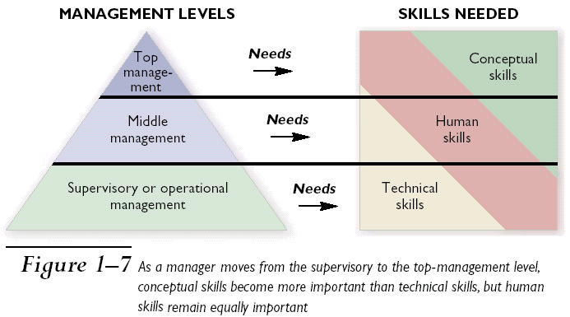
Management Level and Skills

Slide 39
POSDCORB-CEO’s Responsibility
In his "Notes on the Theory of Organization“ Luther Gullick talked about the work of CEO.
Planning
Organizing
Staffing
Directing
Coordinating
Reporting
Budgeting
He mentioned that if an executive's workload becomes too overwhelming, some of the elements of POSDCORB can be organized as subdivisions of the executive, depending on the size and complexity of the enterprise.

Slide 40
Mintzberg’s Managerial Roles
Henry Mintzberg undertook a study on the CEO’S job at work and found that they are engaged in a large number of varied, un-patterned and short duration activities, most of such activities lasted less than nine minutes.
Mintzberg concluded that managers perform 10 different but highly interrelated roles, known as Mintzberg’s Managerial roles.
The term Managerial roles refer to specific categories of managerial behavior.
These 10 roles can be grouped under three primary headings:
Interpersonal Relationship
The Transfer of Information
Decision Making

Slide 41
Mintzberg’s Managerial Roles
ROLE | DESCRIPTION | IDENTIFIABLE ACTIVITIES
Interpersonal
Figurehead | Symbolic head, sets ethical standard | Legal & Social interactions
Leader | Staffing, Training and Motivating employees | Activity related to all employees
Liaison | Maintaining outside contacts for favors & coordinate between dept.s | Developing and nurturing outside contacts& coordinate
Informational
Monitor | Seeks and receives information about organization for control | Evaluate performance of managers in different functions
Disseminator | Shares information received from others for cohesion and progress. | Holding formal & informal internal meetings, shares vision
Spokesperson | Communicate to external world | Holding Board meetings
Decisional
Entrepreneur | Work as Change agent for better | Organize & review program
Disturbance Handler | Responsible for corrective action | Crisis management works
Resource Allocator | Approving all kind of resources | Budgeting & programming
Negotiator | Involve in all major negotiations | Labor union, Supplier, Customer interactions
Notes:
INTERPERSONAL ROLE
Figurehead- ethical guidelines and the principles of behavior employees are to follow in their dealings with customers and suppliers
Leader- give direct commands and orders to subordinates and make decisions
Liaison-coordinate between different departments and establish alliances between different organizations
INFORMATIONAL ROLE
Monitor- evaluate the performance of managers in different functions
Disseminator-communicate to employees the organization’s vision and purpose
Spokesperson- give a speech to inform the local community about the organization’s future intentions
DECISIONAL ROLE
Entrepreneur- commit organization resources to develop innovative goods and services. Takes unchartered routes.
Disturbance handler- to take corrective action to deal with unexpected problems facing the organization from the external as well as internal environment
Resource allocator- allocate existing resources among different functions and departments
Negotiator- work with suppliers, distributors and labor unions

Slide 42
Hierarchy of Objectives & Org. Levels
Vision & Mission
Top Management
Overall
Objectives &
Key result areas.
Overlaps,
depending on the
organization
structure
Divisional objectives
Middle Management
Departmental objectives
Individual objectives
First Line Managers
Objectives set end results – they need to be supported by a hierarchy of sub-objectives, duly networked through the organization to avoid discord and wasted effort.

Slide 43
FUNCTIONS OF MANAGEMENT
The process of achieving the goals are the basic functions of Management , which are
PLANNING
ORGANIZING
STAFFING
DIRECTING
CONTROLLING

Slide 44
PLANNING
Planning is determining the objectives and formulating the methods to achieve them.
Planning involves
identifying what tasks must be performed
outlining how the tasks must be performed, and
indicating when they should be performed
to attain organizational goals,.
A job well planned is half done.
During planning the following basic questions need to be answered:
What am I trying to accomplish i.e. what is my objective?
What resources do I have and do I need to accomplish the same?
What are the methods and means to achieve the objectives?
When the job should be accomplished to meet the organizational objectives?
Is this the optimal path to best serve the organizational objective (Efficiency and Effectiveness)?

Slide 45
Benefits of Planning
Planning establishes coordinated effort.
It gives direction to managers and non-managers alike the direction the organization is going and what they must contribute to reach the objective.
By forcing managers to look ahead,
anticipate change, consider the impact of change and develop appropriate responses, planning reduces uncertainty.
Planning also reduces overlapping and wasteful activities.
Coordination before that activities take place, helps to uncover wastes and redundancies.
Planning establishes objectives or standards that facilitate control.
In planning, objectives are developed. In the controlling function, performance is compared against the established objectives to facilitate taking corrective actions in case of deviation.

Slide 46
Types of Plans
The most popular ways to describe plans are in terms of their
Breadth
Strategic vs. Tactical
Strategic plans include the formulation of objectives, where as Tactical plans describe how these objectives will be attained.
Time frame
Long term vs. Short term
Plans should extend for a time frame which is enough to carry through those commitments that are made today. Short term plans are normally less than one year and the long terms are more than 3 years.
Specificity
Directional vs. specific
Directional plans are flexible which set out general guideline in order to respond to unexpected changes in a highly uncertain environment. Specific plans have clearly defined objectives and reduce problems due to ambiguity.
And Frequency of use
Single use vs. Standing
Single use plan is used to meet the needs of a particular or unique situation. Standing plans provide guidance for repeatedly performed actions in an organization.

Slide 47
Strategic vs. Tactical Planning
Strategic plans
drive the organization’s efforts to achieve its goals. As these plans filter down the organization, they serve as a basis for the tactical plans.
Tactical plans
are sometimes referred to as Operational plans.
Strategic and Tactical plans differ in three primary ways ;-
Time frame
Scope, and
-- known set of organizational objectives.
Time frame & Scope
Tactical plans tend to cover shorter period of time. For instance, an organization’s monthly, weekly and day-to-day plans are almost all Tactical. Strategic plans tend to cover longer period of time and deal less with the specifics.
Objectives
Strategic plans include the formulation of objectives, whereas Tactical plans assume the existence of objectives.

Slide 48
Tactical Plans to Functional Plans
Functional plans indicate how different operations within the organization will help accomplish the overall strategy
Production plans
Financial plans
Facilities plans
Marketing plans
Human resource plans
Logistics plans

Slide 49
Operational Plans
Operational plans identify short-term activities to implement strategic plans
Policies are standing plans that communicate guidelines for decisions
Procedures are rules that describe actions to be taken in specific situations
Budgets are plans that commit resources to projects or activities
Zero based budgets allocate resources as if each budget were brand new

Slide 50
Types of Plans
Type of Plan | Time Frame | Specificity | Frequency of Use
Strategic | Long Term | Directional | Single Use
Tactical | Short Term | Specific | Standing
Functional | Ongoing | Very detailed | Day-to-day
Operational-(Policies, procedures, and rules) | Varies | Varies | Varies

Slide 51
Objective Setting
Of all the functions involved in management, planning is the most important. As the old saying goes, “Failing to plan is planning to fail”.
Setting goals and objectives is the first and most critical step in the planning process.
Although the terms “goals” and “objectives” are often used interchangeably, there is a difference between them:
Goals Objectives
General Specific
Intangible Measurable
Broad Narrow
Abstract Concrete
Strategic – long-range direction, set Tactical – short-range, set by top executives by managers to accomplish goals

Slide 52
Management By Objective (MBO)
MBO was developed by Peter Drucker .
The concept of MBO is closely connected with the concept of planning. The process of planning implies the existence of objectives and is used as a tool/technique for achieving the objectives.
It is a process through which
specific goals are set collaboratively
for
the organization as a whole and
every unit and
individual within;
the goals are then used as a basis
for
planning,
managing organizational activities and
assessing and rewarding contributions.

Slide 53
MBO- an integrated planning and control framework.
MBO is based on the assumption that
people perform better when they know what is expected of them and can relate their personal goals to organizational objectives.
According to the classical theory of management, top management is concerned with objectives setting, directing and coordinating the efforts of middle level managers and lower level staff. However, achievement of organizational objectives is not possible without the cooperation and participation of all persons.
When objectives are set through collective participation, ownership for accomplishment passes downward making the achievement of such objectives easy and quick.
However, MBO not only sets goals but also assigns responsibilities for achieving the same along with authority.

Slide 54
MBO Principles
Cascading of organizational goals and objectives
Align individual targets with corporate objectives
Set performance standards
Participative decision making to agree to the set objectives for each member
Establish a management information system to monitor achievements against objectives
Performance evaluation and feedback

Slide 55
MBO aims at
MBO aims to serve as a basis for
greater efficiency through systematic procedures,
greater employee motivation and commitment
through participation in the planning process.
MBO plans for results instead of planning just for work for a specified period.
MBO provides for
Standards for measuring accomplishment of performance objectives .
Procedures for reviewing performance results.

Slide 56
MBO
Advantages
Focuses employees on most important tasks and objectives.
Focuses supervisor’s efforts on important areas of support.
Contributes to relationship building.
Gives employees a structured opportunity to participate in decision making.
It fosters motivation
It forces managers to plan ahead
Disadvantages
Its time consuming and expensive
It can be misused as a punitive device
Focusing too much attention on easily quantifiable objectives.
Having managers to inform subordinates their objectives.

Slide 57
MBO is not an all pervasive solution
Management by Objectives (MBO) was first outlined by Peter Drucker in 1954 in his book 'The Practice of Management'.
In the 90s, Peter Drucker himself decreased the significance of this organization management method, when he said: "It's just another tool. It is not the great cure for management inefficiency... Management by Objectives works if you know the objectives, 90% of the time you don't."

Slide 58
Organizing
Organizing means assigning the planned tasks to
various individuals or groups within the organization and creating a mechanism to put plans into action.
Includes creating
departments and
job descriptions
It helps in the process of deciding
where decisions will be made,
who will perform what jobs and tasks, and
who will report to whom in the company

Slide 59
Characteristics of an Organization
An organization has a structure.
An organization consists of a group of people striving to reach goals that individuals acting alone could not achieve.
Goals are the purpose that an organization strives to achieve;

Slide 60
Structure Variables
Principles
Chain of command
Span of control
Authority
Power
Responsibility
Departmentalization
Functional
Divisional
Product
Customer
Geographic
Process

Slide 61
Organization Design
Organization Design is a process in which managers develop or change their organization’s structure.
An organization structure defines how job tasks are formally divided, grouped and coordinated.
This process involves making decisions about how specialized jobs should be allocated, the rules to guide employees’ behaviors, and at what levels decisions are to be made.
Six basic elements of organization structure:
Work specialization
Departmentalisation
Unity of command/ Scalar Chain
Span of control
Centralization vs. decentralization, and
Formalization

Slide 62
Elements of Organization Structure
Work Specialization-
In Work Specialization , a job is broken down into a number of steps and each step is completed by an individual or group of individuals, rather than having one individual do the whole job .
Work specialization makes efficient use of diversity of skills that workers hold (Forging, Machining, Welding, Assembly, Painting, etc. before the final product is dispatched).
Departmentalization
Once the jobs have been divided through work specialization, these jobs have to be grouped together so that common tasks can be coordinated. The basis by which jobs are grouped together is called departmentalization.
There are commonly used five departmental structures, discussed in next two slides:

Slide 63
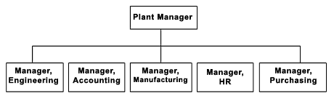
Departmentalization Classifications…
Functional Departmentalization
The activities can be grouped by functions performed. Functional departmentalization seeks to achieve economics of scale by placing people with common skills and orientations into common units.
Product Departmentalization.
It groups jobs by product line. Each manager is responsible of an area within the organization depending of his/her specialization
XYZ Automotive Ltd
Car
Commercial Vehicles
Heavy Vehicles
Notes:
In Functional organization the tasks, people, and technologies necessary to do the work of the business are divided into separate “functional” groups (such as marketing, operations, and finance).

Slide 64
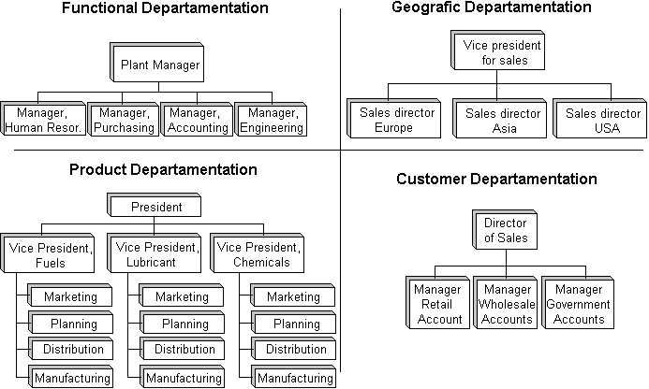
Departmentalization
Based on geographical
territory
Based on customer
segmentation
Process Departmentalization. It groups on the basis of process, for organization where special skills are required to manage the processes.
E.g. Inspection and Shipping department may be one for all the products and customers.

Slide 65
Matrix Organizational Structure
The matrix organizational structure is one in which specialties of both functional and product are combined to provide the advantage of the functional specialization along with focus to simplify and amplify the focus of resources on a narrow but strategically important
product, project, market, customer,
or innovation .

Slide 66
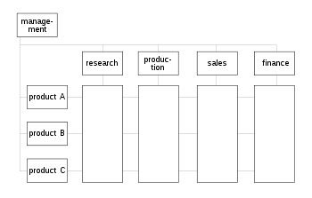
Matrix Organizational Structure
Strictly speaking matrix management is the practice of pooling people with similar skills for work assignments and are managed with more than one reporting line

Slide 67
Elements of Organization Structure
Scalar Chain & Unity of Command:
The unity of command principle helps preserve the concept of an unbroken line of authority. It states that a person should have one and only one superior to whom he or she is directly responsible and straight chain of command (Scalar Chain) that extends unbroken from the top to the bottom.
Span-of-Control
The purpose of organizing is to make human cooperation effective and is limited by the number of persons a manager can ‘supervise’ effectively and efficiently.
“Effective span” is influenced by maturity of managers to skill of the subordinates; from clarity of plan to clarity of delegation.
Notes:
Scalar chain is the formal line of authority which moves from highest to lowest rank in a straight line. This chain specifies the route through which the information is to be communicated to the desired location/person. Straight chain of command that extents unbroken from the ultimate officer to the lowest ranks.

Slide 68
Factors affecting Span of Control
Key factors to review when determining the appropriate span of control within an organization include the following:
Geographical Location, if the branches of a business are widely dispersed, then the manager will find it difficult to supervise each of them, as such the span on control will be smaller.
Organizational size. Large organizations tend have a narrow span of control, whereas smaller organizations often have a wider span of control.
Workforce skill level. Skill level required and competency of the work force (professionally qualified workforce) affects the span of control. Further, Theory Y type of people, need not be supervised much as they are motivated and take initiative to work, as such the span of control will be smaller.
Nature of Job. The complexity or simplicity of the tasks performed by the employees will affect the number of desirable direct reports. If the task that the subordinates are performing are similar, then the span of control can be wider, as the manager can supervise them all at the same time.
Organizational culture. Flexible workplaces usually have a wider span of control because employees are given more autonomy and flexibility in their work.

Slide 69
Fayol’s bridge
Scalar chain in the organization structure provides for straight chain of command that extends unbroken from the ultimate officer to the lowest ranks. The principle suggests that there should be a clear line of authority from top to bottom linking all managers at all levels. It is considered a chain of command.
To avoid information overload in a large organization having scalar chain and unity of command,
Henry Fayol has proposed that subordinate employees should be allowed to communicate directly with each other.
This principle became known under the name of Fayol's bridge.
Decision power is distributed to individuals on lower levels in the organization, and only decisions that exceed the pre-defined decision scope of an employee are referred upwards.

Slide 70
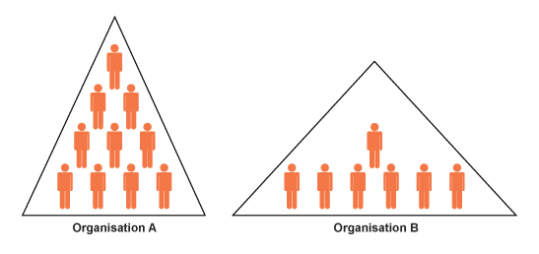
Tall vs. Flat Structure
Organization Structure are classified into in to a tall (vertical) (Organization A) structure or
a flat (horizontal) (Organization B) structures.
Large, complex organizations often require a taller hierarchy. In its simplest form, a tall structure results in one long chain of command similar to the military.
Flat structures have fewer management levels, with each level controlling
a broad area or group.
Flat organizations focus on empowering employees rather than adhering to
the chain of command. Small organizations generally have flat structures.

Slide 71
Centralized vs Decentralized Structure
The degree to which the authority is delegated within an organization is indicated by Centralization and Decentralization.
A centralized structure has a greater degree of control, while a decentralized structure involves a greater degree of delegated authority to the regions or to subordinates.
Centralized Keep decision making power at the top of the hierarchy 2) Don't delegate to local or lower levels | Decentralized 1) Power and authority to make decisions delegate from head office to lower and local levels 2) Less uniformity 3) Decisions made in relation to local circumstances
Advantages 1) Consistent policies, greater control and standardized procedures 2) Quicker decision making 3) Branches are identical, so customer knows what to expect 4) Tight financial control | Advantages 1) Empower local managers 2) Local knowledge may benefit decentraliszd operation managements (e.g. sales and promotional initiatives) 3) Reduces day to day communication with head office 4) Business is more flexible as it is able to respond to local issues faster 5) Improved motivation and performance
Disadvantages 1) Local managers may have better knowledge of customer needs 2) Motivation of local managers may be affected 3) Inappropriate decision at local level | Disadvantages 1) Customers may prefer the uniformity of branches 2) Local managers may not see the bigger picture

Slide 72
Contingency variables Affecting Structures
The most appropriate structure to use will depend on contingency factors.
There are two generic organization structures:
Mechanistic Organization
Organic Organization

Slide 73
Mechanistic Organization
The Mechanistic Organization (Bureaucratic) is the natural result of combining the six elements of structure.
Adhering to the chain–of-command principle ensured the existence of a formal hierarchy of authority, with each person controlled and supervised by one person.
Keeping the span of control small at increasingly higher levels in the organization created tall, impersonal structures with increasing rules and regulations for standard practices.
In such organization, work specialization creates jobs that are simple, routine and standardized.

Slide 74
Organic Organization
The Organic organization is a highly adaptive form that is as loose and flexible as the mechanistic organization is rigid and stable.
It has division of labor, but the jobs people do are not standardized.
Employees tend to be professionals who are technically proficient and trained to handle diverse problems.
The organic organization is low in centralization so that the professional can respond quickly to problems
Low in Centralization:
because top management cannot be expected to possess all the varied expertise that is necessary to make decision.

Slide 75
Other New Age Structures
Multi-national Structure, -common in global companies, such as Procter & Gamble, Toyota, Unilever etc.
This structure can be seen as a complex form of the matrix, as it maintains coordination among products, functions and geographic areas.
In general, over the last decade, it has become increasingly clear that through the forces of globalization, competition and more demanding customers, the structure of many companies has become flatter, less hierarchical, more fluid and even virtual.
Team Structure
One of the newest organizational structures developed in the 20th century is Team Structure.
In small businesses, the team structure can define the entire organization
Teams can be both horizontal and vertical.
While an organization is constituted as a set of people who synergize individual competencies to achieve newer dimensions, the quality of organizational structure revolves around the competencies of teams in totality

Slide 76
SQC
Statistical Quality Control

Slide 77
Introduction to SQC
Talking about solving quality problems is not enough. We need specific tools that can help us make the right quality decisions.–
These tools come from the area of statistics and are used to help identify quality problems in the production process as well as in the product itself.
Statistical quality control (SQC) is the term used to describe the set of statistical tools used for measuring the quality performance, for acceptance/rejection decisions and to initiate CA/PA by quality professionals.

Slide 78
Sample represents Population
Statistical method is used for determining the extent to which quality goals are being met without necessarily checking every item produced.
This also helps in indicating whether or not the variations which occur in the conversion process are exceeding the limits of tolerances allowed by the customer and
This provides early warning for CA/PA
Thus it helps us to decide whether to reject or accept a particular product.
And ensure that the products produced are meeting customer needs.

Slide 79
SQC- Types of Variations
Statistical quality control exercise begins with the assumptions that no two products manufactured by a process are absolutely identical.
If variability is inevitable in any product or process, then how much of the variation is unavoidable? This raises the need for quality control.
The causes of variation in the quality of products or services from standards can be divided into the following two categories
Chance or common causes of variation
They are inherent to the process and cannot be reduced or eliminated without modification in the process itself. When the variability present in a process is confined to chance variation, the process is said to be in a state of statistical control.
Assignable causes of variation
The variation may be due to non-random causes. This may be due to the abnormality in the input material, or may be abnormality in the manufacturing processes, caused by the inefficiency of the operator or the machine.

Slide 80
Three SQC Categories
SQC can be divided into three broad categories:
Descriptive statistics
Descriptive statistics are used to describe quality characteristics and relationships.
e.g. the mean, standard deviation, and range
Acceptance Sampling
Acceptance sampling is the process of randomly inspecting a sample of goods and deciding whether to accept or reject the entire lot based on the results.
Does not help to catch in-process problems
Statistical process control (SPC)
Involves inspecting the output from a process
Quality characteristics are measured and charted
Helpful in identifying in-process variations and taking corrective actions

Slide 81
Use of the Three
Descriptive Statistics
Descriptive statistics are used to describe certain quality characteristics, such as the central tendency and variability of observed data. Although descriptions of certain characteristics are helpful, they are not enough to help us evaluate whether there is a problem of unacceptable quality with the lot.

Slide 82
Measure of Central tendency
A measure of central tendency is a single number used to represent the centre of the Grouped Data.
Different variables may possess different numerical characteristics. So different measures of Central Tendency is required.
Mode
Median
Mean
This class of measures can be for group or ungrouped data.

Slide 83
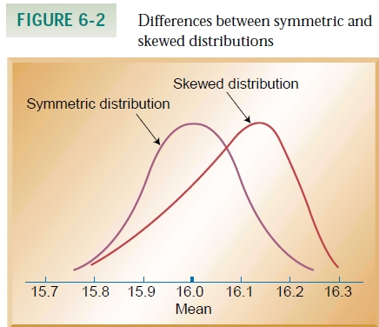
The Mode
The Mode is the most frequently occurring value in a group of raw scores.

Slide 84
The Median
The Median is defined as the middle value (of cases) of n values of X objects arranged in order of size
For odd no of cases the Middle Value will be (n+1)/2.
For even no of cases the Middle Value will be half way between the n/2 and (n+1)/2.

Slide 85
The Mean
x1+x2+x3+….. + xn
For Samples : X̅ = -------------------------------------
n
X1+X2+X3…………XN
For populations : μ= ----------------------------
N

Slide 86
Use of the Three
Acceptance Sampling
Descriptive Statistics does not help us in deciding whether a group of data is acceptable or not.
Acceptance sampling can help us to do this. Acceptance sampling helps us to decide whether desirable quality has been achieved for a batch of products, and whether to accept or reject the items produced.

Slide 87
Usefulness of Acceptance Sampling
Acceptance sampling is very useful when
Large no of items are processed in a short time
The cost of passing defective is low
Fatigue and boredom is caused by large no of items inspection.
Destructive testing is required

Slide 88
RISK
RISKS for the producer and consumer in sampling plans:
Acceptable Quality Level (AQL)
Max. acceptable percentage of defectives defined by producer.
α (Producer’s risk)
The probability of rejecting a good lot.
Lot Tolerance Percent Defective (LTPD)
Percentage of defectives that defines consumer’s rejection point.
β (Consumer’s risk)
The probability of accepting a bad lot.

Slide 89
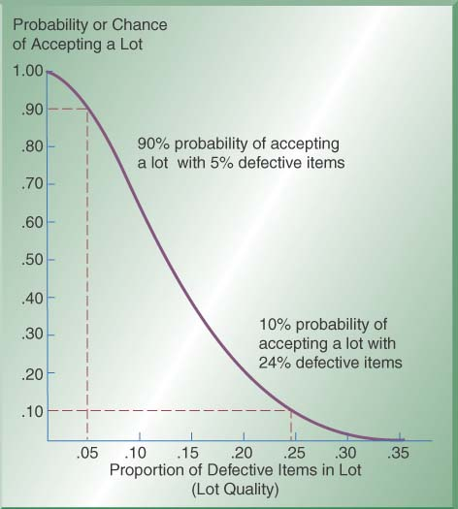
Operating Characteristics (OC) Curves
Operating Characteristic (OC) Curve: This curve plots the probability of accepting the lot (Y-axis) versus the lot fraction or percent defectives (X-axis). The OC curve is the primary tool for displaying and investigating the properties of a LASP (Lot Acceptance Sampling Plan).
X-axis shows % of items that are defective in a lot- “lot quality”
Y-axis shows the probability or chance of accepting a lot
As proportion of defects increases, the chance of accepting lot decreases
Example: 90% chance of accepting a lot with 5% defectives; 10% chance of accepting a lot with 24% defectives

Slide 90
Introducing Statistical Process Control
A manufacturing process when in a statistical control also provides the limits of its natural variation, which may be calculated with the help of Statistical tools. Such limits are drawn for process control at the shop floor level and are known as Control Charts.
Abnormality in the process causes variations in the products which are not acceptable by the customer and can be tracked with the help of the above Control Charts during the manufacturing process.
Information received by plotting observed quality data on the Control Charts can be used to control the process and produce goods within the acceptable quality standards. This is known as Statistical Process Control.

Slide 91
Control Charts
Control Charts are graphs that establish control limits of a process
Control limits
upper and lower bands of a control chart
Types of charts
Variables
range (R-chart)
mean (x̅ – chart)
Attributes
p-chart
c-chart

Slide 92
Control Charts
Control Charts provide a basis of monitoring variations in the predetermined quality of a product or process.
The use of control charts help to
Focus on the time dimension in which a system produces products or services
Identify the nature of variation in the process during operation and
Ensure that only acceptable products or services are produced by monitoring the process average, which is expected to stay within the bounds of upper and lower statistical limits.
Whenever an out-of control situation is detected, corrective action will be taken to bring the process back into control.
A Control Chart is essentially a graphic device for presenting data so as to identify the frequency and extent of variations from established standards.

Slide 93
Control Charts by Variables
Control Charts by variables are the followings
The Average Chart (X̅- Chart), which assumes the central tendency of the process
The Range Chart (R-chart), which measures the spread of the process
Since the Average Chart and Range Charts are usually used together , they are commonly known as (X̅-R) chart.

Slide 94
Theory underlying X̅-R Chart
Average of a sample of several items tend to cancel out the normal process variations and Undesirable changes due to assignable causes thereafter become visible.
Statistical limits of the X̅-R chart are based on the concept-
The Arithmetic Means of samples are distributed according to normal distribution with sample mean X̿, which is equal to mean of the population μ and Standard Deviation of sample means σ x̅ equal to √σ/n, where σ is the standard deviation of the Population and n is the sample size.

Slide 95
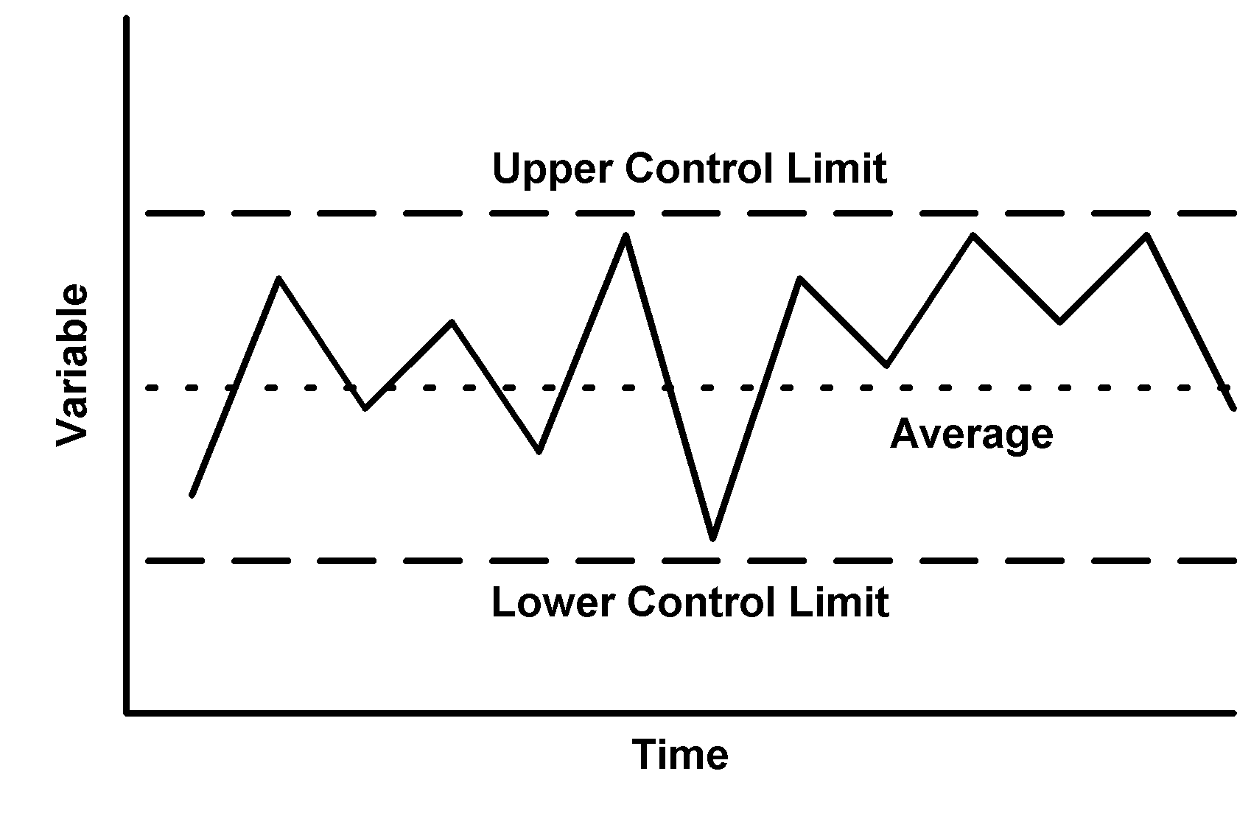
Control Chart
A Control Chart consists of three horizontal lines called Control limits which are within +/- 3 Standard Deviation of the Statistical measures
Upper Control Limit (UCL) indicates the upper limits of the tolerance
Lowe Control limits (LCL) indicating the lower limit of the tolerance.
Average or Central line should be the designed mean .
If all the product measures are found to be between the upper and lower control limits, it is assumed that the process is “in Control” and only chance causes are present.

Slide 96
Setting Up of Control Chart Using X̄ -R Chart
The Construction of an X̄ Chart is based on the Central Limit Theorem. This states that
Regardless of the population of all parts of services, the distribution of X̄ s (each of which
is the mean of a sample drawn from the population) will tend to follow a normal curve
as the sample size increases, where
The mean of population = μ
= sample mean
And Standard Deviation of sample
means σ x̅ equal to √σ/n, where σ is
the standard deviation of the Population
and n is the sample size.
Control Charts can be recalculated as
Where, A2, D3, D4 are Statistical Constants

Slide 97
Steps to follow in making X̅- R Chart
For X̅ Chart
Step-1 :- Calculate Sample Mean (X̅) and Sample Range (R) of each sample lot
Step-2 :- Calculate total Population average and the Mean Range (X̿ and R̅ )
Step-3 :- Set up a X̅ Control Chart for the Average from X̿ + A2 R̅ for UCLx̅ and X̿ - A2 R̅ for LCLx̅
For R-Chart
Step-4 :-Calculate Control Limits for the Range Chart by using UCLR as D4R̅ and LCLR as D3R̅
Step-5:- Set up a Range Chart and comment with both X̅ and R chart.

Slide 98
Problem Sum
A line inspector in an engineering company recorded dimensions of each of the 5 jobs selected at the end of every half an hour of the 5 hours in the shift. The design specifications are 25.0 +/- 0.10.
Plot X̅-R chart and find out which of the given observations are out of control. Given- A2= 0.5768, D3 =0, D4= 2.114
Sample Individual Measurements No. 1 2 3 4 5
1 25.00 25.01 25.00 25.03 25.01
2. 25.00 25.03 25.00 25.04 25.03
3. 25.01 25.02 25.02 25.03 25.02
4. 25.01 25.02 25.02 25.01 25.04
5. 25.02 25.02 25.03 25.03 25.00
6. 25.06 25.03 25.02 25.00 24.99
7. 24.99 24.98 25.02 25.02 24.99
8. 25.02 25.01 25.01 24.99 25.02
9. 25.03 25.01 24.97 25.01 25.03
10. 25.02 24.99 24.99 24.98 24.97

Slide 99
Computations: -
Sample No. | Individual Measurements 1 2 3 4 5 |  |  |  |  | X̄ | R
1 | 25.00 | 25.01 | 25.00 | 25.03 | 25.01 | 25.01 | 0.03
2 | 25.00 | 25.03 | 25.00 | 25.04 | 25.03 | 25.02 | 0.04
3 | 25.01 | 25.02 | 25.02 | 25.03 | 25.02 | 25.02 | 0.02
4 | 25.01 | 25.02 | 25.02 | 25.01 | 25.04 | 25.02 | 0.03
5 | 25.02 | 25.02 | 25.03 | 25.03 | 25.00 | 25.02 | 0.03
6 | 25.06 | 25.03 | 25.02 | 25.00 | 24.99 | 25.02 | 0.07
7 | 24.99 | 24.98 | 25.02 | 25.02 | 24.99 | 25.00 | 0.04
8 | 25.02 | 25.01 | 25.01 | 24.99 | 25.02 | 25.01 | 0.03
9 | 25.03 | 25.01 | 24.97 | 25.01 | 25.03 | 25.01 | 0.06
10 | 25.02 | 24.99 | 24.99 | 24.98 | 24.97 | 24.99 | 0.05
 |  |  |  |  |  | X̄̄ | R̄
 |  |  |  |  |  | 25.01 | 0.04

Slide 100
X̄ Chart
Diameter Measurement
UCL
CL
LCL
Sample N0.
Computations: - Central Line = CLx̄ = X̿ = 25.01 Upper Control Limit UCLx̄ = X̿ + A2R̄ = 25.01+ .5768X.04 = 25.03 Lower Control Limit LCLx̄ = X̿ - A2R̄ = 25.01- .5768X .04 = 24.99

Slide 101
R-Chart
UCL
Range Value
CL
LCL
Sample No.
Computation
CLR = 0.04
UCLR = D4xR̄ = 2.114x 0.04 = 0.085
LCLR = D3xR̄ = 0

Slide 102
Control Charts by Attributes
This form of inspection is where the items comprising the sample are classified into two factions :
Acceptable “ and
“Non-acceptable”.
Such an inspection is termed as “Inspection by attributes”. This includes
Quantitative measurements are not possible as with the inspection for damages, matching of color against a standard shades, presence of bars, etc.
Quantitative measurements consume too much time with the inspection of p.c.d. of drilled holes etc. ( uses GO or NOGO gauge)

Slide 103
Control Charts by Attributes
The Control Charts by Attributes are basically the followings.
The Fraction Defective Chart (p-Chart) which records the proportion of defective items in a sample
The Number Defective Chart (np-Chart) which records the number of defective items in a sample
The Defects Chart (C- Chart) which records the number of defects in a component/ product

Slide 104
Control chart for Fraction Defectives
The control charts for fraction defectives is used where the products manufactured in the shops or products received from vendors are inspected and classified as either accepted or rejected.
This two way classification naturally leads to a binomial description of the standard error of the mean.
The Fraction Defective Chart (p-Chart) which records the proportion of defective items in a sample
The Number Defective Chart (np-Chart) which records the number of defective items in a sample

Slide 105
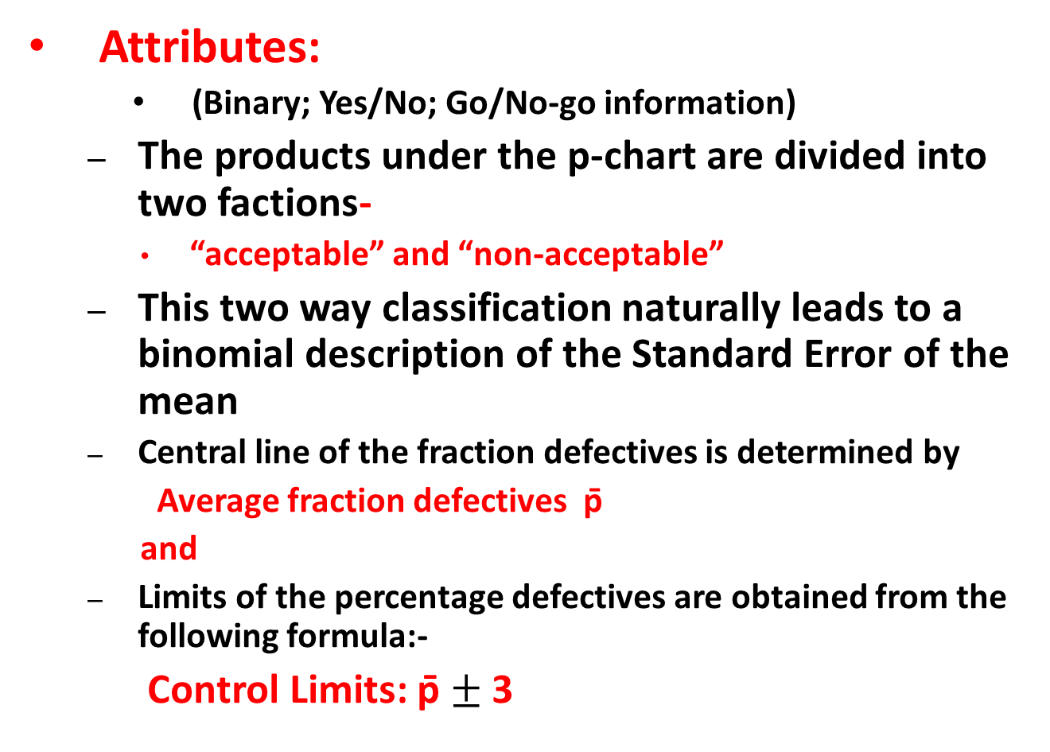
p-Chart
Attributes:
(Binary; Yes/No; Go/No-go information)
The products under the p-chart are divided into two factions-
“acceptable” and “non-acceptable”
This two way classification naturally leads to a binomial description of the Standard Error of the mean
Central line of the fraction defectives is determined by
Average fraction defectives p̄
and
Limits of the percentage defectives are obtained from the following formula:-
Control Limits: p̄ $±$3
-

Slide 106
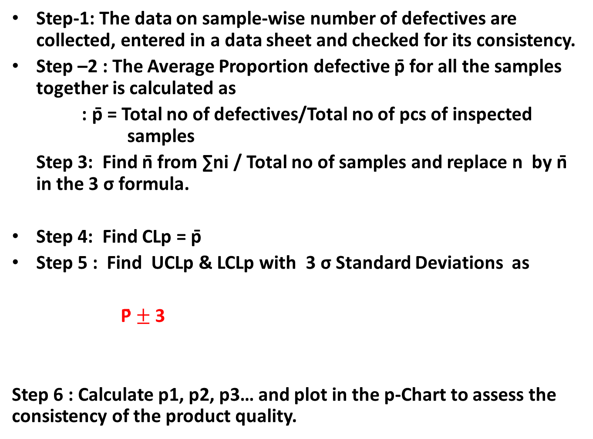
Steps to Construct p-Chart
Step-1: The data on sample-wise number of defectives are collected, entered in a data sheet and checked for its consistency.
Step –2 : The Average Proportion defective p̄ for all the samples together is calculated as
: p̄ = Total no of defectives/Total no of pcs of inspected samples
Step 3: Find n̄ from ∑ni / Total no of samples and replace n by n̄ in the 3 σ formula.
Step 4: Find CLp = p̄
Step 5 : Find UCLp & LCLp with 3 σ Standard Deviations as
P̄ $±$3
Step 6 : Calculate p1, p2, p3… and plot in the p-Chart to assess the consistency of the product quality.
-

Slide 107
Problem Example
Sample Number of No of item in each
Defective Sample
1 3 20
2 2 20
3 1 20
4 1 20
5 2 20

Slide 108

Computation of p-Chart
Sample No. | No of Defectives in each sample | No of items in each sample |  | Fraction Defective
1 | 3 | 20 |  | 0.15
2 | 2 | 20 |  | 0.1
3 | 1 | 20 |  | 0.05
4 | 1 | 20 |  | 0.05
5 | 2 | 20 |  | 0.1
Average Fraction Defective = p̄ = $\frac{Total No of Defective}{Total items inspected}$
= 9/100 = 0.09
Average no. per sample, n = 5x20/5= 20
Upper Control Limit = p̄ + 3 $√$p̄( 1-p̄)/n = 0.09 + 0.192 = 0.282
Lower Control Limit = p̄ - 3 $\sqrt{p}̄̄(1−p̄)/n$ = 0.09- 0.192
= -0.102=0
(Since the negative control limits are always taken as zero.)
-
-
--

Slide 109
Control Chart for Fraction Defective
UCL
CL
LCL
Sample No.

Slide 110
Problem Sum on p-chart
Six consecutive lots received from a vendor were inspected by sampling process In-coming Inspection of the buyer. Sample lot was varying as per the variation in the lot size. The inspection results are as follows :-
Construct a control chart for fraction defective and no of defectives.
Sample No | 1 | 2 | 3 | 4 | 5 | 6
Lot Size | 2850 | 1860 | 480 | 970 | 4385 | 2568
Sample Size | 125 | 125 | 50 | 80 | 200 | 125
No. of Defectives | 1 | 3 | - | 2 | 4 | 1

Slide 111
Solution
p̅ = Total No of defective items/ Total no. of items inspected
= (1+3+0+2+4+1)/125+125+50+80+200+125)=11/705= 0.016
Since the sample size is varying, find out avg. no. of pcs inspected n̅=705/6=117.5
Then UCLp= p̅+ √ p̅(1- p̅)/n̅ =.016+3X00116= 0.051
LCLp=-0.019=0
np-chart
CLnp= n̅. p̅=0.016X117.5=1.88
UCLnp= n̅. p̅+ 3 √ n̅. p̅ (1- p̅)=1.88+3 √.016X117.5 (1.0X.016)=1.88+4.08=5.96
LCLnp= 1.88-4.08=0

Slide 112
Defect Chart
The Defects Chart (C- Chart) which records the number of defects in a component/ product. The defects could occur at any spot but the probability of their occurrence at a particular spot is very small whereas the number of spots where the defects can occur are very large.
Such a situation is correctly described by Poission distribution with
Mean equal to average number of defects in all samples , say c̅. And
Standard deviation equal to √ c̅
Eg. Cloth is set by the number of imperfections in a given length.

Slide 113
Control Limits of c-Chart
Central Line , CLc = c̅
Since value of c can never be negative hence if the lower control limit (LCLc) works out to be negative, then it taken equal to zero.
Upper Control Limit, UCLc = c̅ +3√ c̅
Lower Control Limit LCLc = c̅ - 3√ c̅

Slide 114
Problem Sum on c-Chart
Ten woolen carpets were studied for total no. of defects in their texture. The details of the number of defects in each carpet are given below.
Carpet No. 1 2 3 4 5 6 7 8 9 10
No. of defects 2 4 3 5 1 3 2 3 4 3
All ten carpets are however were regarded as acceptable by the QC of the company. Construct a Control Chart for number of defects and comment.
Central Line-c̅ = Total no. of defects/ Number of carpets = 30/10 = 3
Upper Control Limit (UCLc) = c̅ + 3 √ c̅ = 3+ 3 √ 3= 3+5.2=8.2
Lower Control Limits (LCLc) = c̅ - 3 √ c̅ = 3 - 3 √ 3 = 3-5.2 = -2.2=0

Slide 115
Control Charts for No. of Defects
UCL
CL
No. of Defects
LCL
Sample No. (Carpet No.)

Slide 116
Process Capability Index Cp/C_{pk}
Cp And Cpk are the process capability indices.,
Cp-Measures the variation.,
how close the measures readings.,
Cpk -Measures the central tendency.,
how close the measures readings to Nominal

Slide 117

Production Function
Notes:
Each type of business or industrial activity, or simply any productive activity
(a productive activity is one that combines production factors with the objective of obtaining
a result in the form of goods or services) will have a different production function.

Slide 118
Cobb- Douglas Production Function
In economics, a Production Function represents the relationship between the output and the combination of factors, or inputs, used to obtain it.
Q=f(L,K)
Where: - Q is the quantity of products - L the quantity of labor applied to the production of Q, for example, hours of labor in a month. - K the hours of capital applied to the production of Q, for example, hours a machine has been working for the production of Q.
There can be other inputs, K and L are just examples.
The Cobb-Douglas production function is a particular form of the production function. It is widely used because it has many attractive characteristics, as we will see below.
The basic form of the Cobb-Douglas production function is as follows:
Q(L,K) = A L^β K^α
Where: - Q is the quantity of products. - L is the quantity of labor. - K is the quantity of capital. - A is a positive constant. - β and α are constants between 0 and 1.

Slide 119
Extension of Cobb-Douglas Production Function
The production function is the relationship that exists between the obtained output and the combination of factors used to obtain it.
Given the state of technology at any given moment in time, the production function shows us that the quantity of product Q that is obtainable by a business is a function of the quantities of
capital (K),
labor (L),
land (P) and
business initiative (H),
so that:
Q = f(K,L,P,H) ……..

Slide 120
Production Management
Production Management is defined as
Planning, implementation, and control of industrial production processes to ensure smooth and efficient operation.
Production management responsibilities include the traditional “five M's”: man, machine, method, material and money.
Managers are expected not only
to get the job done by the workforce
but also
to develop and maintain an efficient production process by building a learning organization,
where
environment is built for the employees to continuously learn and adapt new technologies, equipment and schedules.

Slide 121
Production to Operation Management
Production management which was formerly considered as manufacturing management only, now after inclusion of services into its scope, is broadly known as operations management.
The growth of service industry has brought with it the term operations management. It is a general term these days.
Operation Management deals with
managing resources
inputs:
machines, raw materials, human skills, etc.,
the conversion process, and
distribution of finished goods and services (outputs to the customers).

Slide 122
Systems approach to Management
Operation Management
Inputs
Conversion
Subsystem
Outputs
Control
Subsystem
Organization as a System receives Input, transforms it through a Process for Output, receives feed back from customer for improvements. either at Input stage or at conversion sub-system.

Slide 123
Functions of Production Management
Functions of Production and Operation Management are as follows:-
Planning
Planning conversion system
Operation strategies
Forecasting
Product and process choice
Operation capacity arrangement
Facility location planning
Layout planning
Schedule conversion system
Scheduling system in aggregate planning
Execution
Organizing for conversion
Job design , production/operation standards, works management
Executing as per plan
Implementing the plan efficiently and effectively
Controlling
Manage the deviation and improve
Review the process and product for continuous improvements
Material control
Inventory control
Material requirement planning
Managing for world class competition
Managing for quality
Quality control and analysis
Introduction of modern manufacturing system

Slide 124
Objectives of Production Management
Producing the right kind of goods and services that satisfies customer’s needs –Effectiveness objective
Maximizing output of goods and services with minimum resource inputs– Efficiency objective
Ensuring that goods and services produces that conform to quality needs of the customer
–Quality objective
Minimizing through put time –time required for conversions-by reducing delays waiting time, idle time etc.– Lead time objective
Minimizing cost of production-Cost objective
Maximizing utilization of machines, manpower, capital etc.– Capacity utilization objective

Slide 125
Types of Production Systems
On the basis of material flow characteristics the production system can be grouped into the following four categories
Mass Production or Flow line production system
Batch production system
Job shops
Unit manufacture or Project
Depending on the flow characteristics inside the system, the manufacturing system can be simple or complex to manage

Slide 126
Types of Production System
Job Shops: Small lots, low volume, general equipment, skilled workers, high-variety.
Ex: tool and die shop, veterinarian’s office
Batch Processing: Moderate volume and variety. Variety among batches but not inside.
Ex: paint production, Cake shop (Mio Amore)
Repetitive/Assembly: Semi-continuous, high volume of standardized items, limited variety.
Ex: auto plants (Maruti car manufacturing), cafeteria
Continuous Processing: Very high volume and no variety.
Ex: steel mill (SAIL), Indian Oil Refinery
Projects: Non-routine jobs.
Ex: AJC Bose Road Flyover

Slide 127
Product – Process Matrix
Dimension | Job Shop | Batch | Repetitive | Continuous
Job variety | Very High | Moderate | Low | Very low
Process flexibility | Very High | Moderate | Low | Very low
Unit cost | Very High | Moderate | Low | Very low
Volume of output | Very low | Low | High | Very high

Slide 128
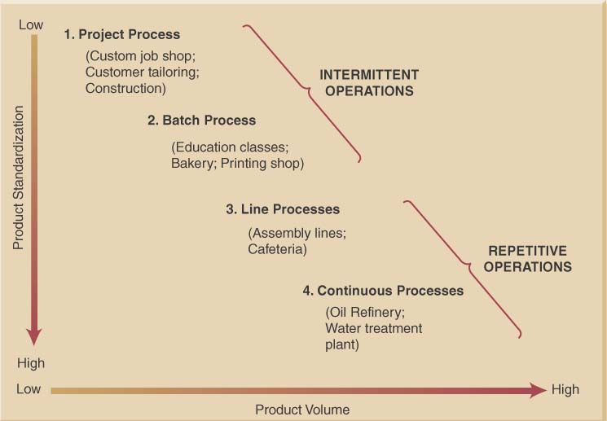
Product-Process Grid

Slide 129
Process Types
Process types can be:
Project process (Job Shops) – make a one-at-a-time product exactly to customer specifications
Batch process – small quantities of product in groups or batches based on customer orders or specifications
Line process (Repetitive Assembly)– large quantities of a standard product
Continuous process – very high volumes of a fully standard product
Process types exist on a continuum

Slide 130
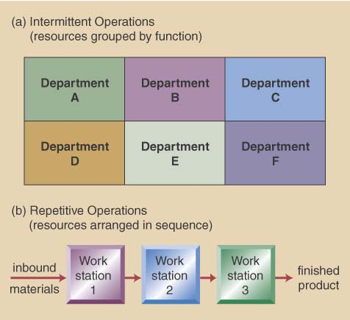
Intermittent VS. Repetitive Facility Layouts

Slide 131
Process Selection Considerations
Process selection is based on five principal considerations
Product-Process Grid
Degree of vertical integration
Flexibility of resources
Mix between capital & human resources
Degree of customer contact

Slide 132
Process Decisions-Vertical Integration & Make or Buy
Vertical integration refers to the degree a firm chooses to do processes itself- raw material to sales
Backward Integration means moving closer to primary operations
Forward Integration means moving closer to customers
A firm’s Make-or-Buy choices should be based on the following considerations:
Strategic impact
Available capacity
Expertise
Quality considerations
Speed
Cost (fixed cost + variable cost)make = Cost (fixed cost + Variable cost)buy
Business are trending toward less backward integration, more outsourcing

Slide 133
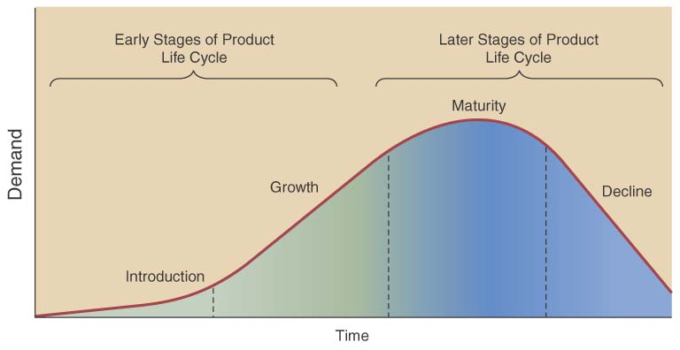
Product Life Cycle also affects decisions
Product life cycle – series of changing product demand
Consider product
life cycle stages
Introduction
Growth
Maturity
Decline
Facility & process investment depends on life cycle

Slide 134
Design of Services
Service design is unique in that the service and entire service concept are being designed
must define both the service and concept
- Physical elements, aesthetic & psychological benefits
e.g. promptness, friendliness, ambiance
Product and service design must match the needs and preferences of the targeted customer group

Slide 135
Designing Services vs Products
Services are different from manufacturing as they;
Produce intangible products
Involve a high degree of customer contact
Type of service is classified according to degree of customer contact

Slide 136
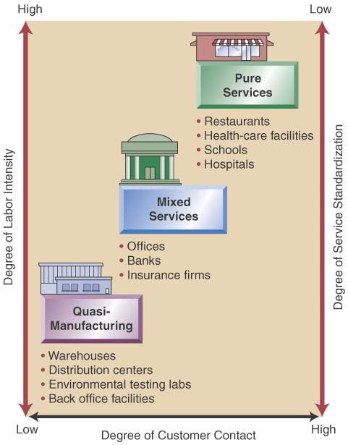
Service Design Matrix
Service Characteristics
Pure services
Quasi-Manufacturing
Mixed services
Service Package
The physical goods
The sensual benefits
The psychological benefits
Differing designs
Substitute technology for people
Get customer involved
High customer attention

Slide 137
TQM
Total Quality Management

Slide 138
TQM Definition
TQM is defined as “a management philosophy” that builds
a customer-driven organization dedicated to total customer satisfaction
through
continuous improvement in the effectiveness and efficiency of the organization and its processes.”
It uses PDCA Cycle (also Known as Deming Wheel ) as a tool to bring in continuous improvements.
Progress in the search for excellence depends largely on the leadership.
At work, total quality management (TQM) is best promoted when a leader is able to get everyone to be involved in activities designed to increase customer satisfaction.
TQM requires continual changes that contribute to quality improvement and the leader is responsible for finding the best avenue to achieve this.

Slide 139
TQM provides competitive edge to the organization
Customer buys the total experience not only the product alone. It starts from pre-selling activities (enquiry/quotation etc.), then the quality of the product or services delivered including the delivery and finally the after sales service including disposal.
TQM focuses on improving the total customer experience and on a continuing basis.
TQM is both a philosophy and a set of management guiding principles for managing an organization.
It typically regards customer reaction as the best measure of quality.
It uses the idea of internal customers to substitute for external customers in measuring the quality of many of the operations in the organization.
TQM regards focusing on quality as a way to gain competitive advantage. It is argued that if quality is improved, costs will drop and organizations will respond more quickly and effectively to customer requests.

Slide 140
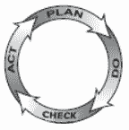
Plan-Do-Check-Act (PDCA) Cycle
The PDCA Cycle is a checklist of the four stages which is used to move from `problem-faced' to `problem solved‘ stage.
It is a four–step model for carrying out change. Just as a circle has no end, the PDCA cycle should be repeated again and again for continuous improvement.
When to Use Plan–Do–Check–Act
As a model for continuous improvement.
When starting a new improvement project.
When developing a new or improved design of a process, product or service.
When implementing any change.
The concept was originally developed by Walter Shewhart. But it was popularized by Edward
Deming for organization’s
improvement. Because of
this the cycle is also known
as Deming Wheel.

Slide 141
Plan–Do–Check–Act (PDCA)Procedure
Plan.
Recognize an opportunity and plan a change.
Do.
Test the change. Carry out a small-scale study.
Check.
Review the test, analyze the results and identify and record the learning.
Act.
Take action based on what is learned in the study step:
If the change did not work, go through the cycle again with a different plan. If you were successful, incorporate what you learned from the test into wider changes. Use what you learned to plan new improvements, beginning the cycle again.

Slide 142
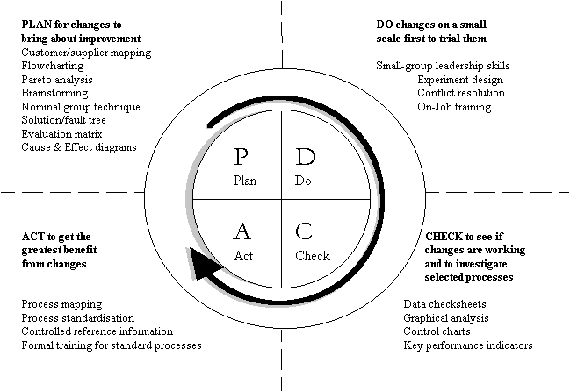
Common Improvement Tools used
in PDCA Cycle
Plan-Do-Check-Act describes the overall stages of improvement activity,
where other specific quality management, or continuous improvement, tools and techniques
are used for solving the problem. Some of the popularly used tools and techniques are shown
below which are used at each stage of the PDCA Cycle.

Slide 143
KAIZEN-what it means
KAI—CONTINUOUS
ZEN—GOOD
It’s a Japanese Management concept
-believes in
Incremental (Gradual & Continuous)
& Change ( for Improvement)

Slide 144
Kaizen Definition
Kaizen is defined as improvement.
It is a philosophy of continuing improvement that should be considered, not only at work, but at home as well.
When applied to the workplace Kaizen means continuing improvement that involves all employees - from top executives to laborers, and the managers in between.

Slide 145
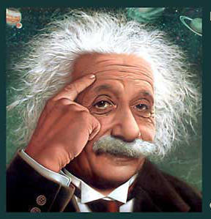
Without Change
There Can Be No Improvement
“The definition of insanity is doing the same thing over and over and expecting different results.”
Albert Einstein

Slide 146
Kaizen Implementation
Discard Conventional ideas
Think Positive
Question Current Practice
Identify low hanging fruits to target first
Find Root Causes
Choose the best among the alternative solutions
Implement
Work in a team to achieve MAXIMUM
Meeting of Kaizen group once in Month

Slide 147
Taguchi’s View of Variation
Traditional view is that quality within the LS and US is good and that the cost of quality outside this range is constant, where Taguchi views costs as increasing as variability increases, so seek to achieve zero defects and that will truly minimize quality costs.
High
High
Incremental
Cost of
Variability
Incremental
Cost of
Variability
Zero
Zero
Lower
Spec
Target
Spec
Upper
Spec
Lower
Spec
Target
Spec
Upper
Spec
Traditional View
Taguchi’s View
Notes:
30

Slide 148
6σ
Six Sigma-
a Business Management Strategy

Slide 149
Six Sigma
The term “Six Sigma Process," comes from the notion that
if a process has
a variation of up to six standard deviations from the mean are within the upper and lower specification limits,
there will be practically no items that will fail to meet the specifications;

Slide 150
Six Sigma
Six Sigma is a data driven approach which makes use of measuring and analyzing data to determine how defects and differences could be minimized to the virtual zero defect level.
Statistically the defect level targeted is 3.4 defects per million cycles/products, while a process is being run.
Six sigma is a customer based approach realizing that defects are expensive. Fewer defects mean lower costs and improved customer loyalty.
The lowest cost, high value producer is the most competitive provider of goods and services.
Six Sigma leads to achieve strategic business results.

Slide 151
Six Sigma Improvement Methods DMAIC vs. DMADV
Define
Measure
Analyze
Continuous Improvement
Reengineering
Improve
Design
Control
Validate

Slide 152
Supply Chain
Inventory Control & Supply Chain Management

Slide 153
What is a Supply Chain?
The concept of Supply Chain Management is based on two core ideas.
The first is that
practically every product that reaches an end user represents the cumulative effort of multiple organizations. These organizations are referred to collectively as the supply chain.
The second idea is that
while supply chains have existed for a long time, most organizations have only paid attention to what was happening within their “four walls.” Few businesses understood, much less managed, the entire chain of activities that ultimately delivered products to the final customer. The result was disjointed and often ineffective supply chains.

Slide 154
What is Supply Chain Management?
Supply chain management is the active management of supply chain activities to maximize customer value and achieve a sustainable competitive advantage.
It represents a conscious effort by the supply chain firms to develop and run supply chains in the most effective & efficient ways possible.
Supply chain activities cover everything from product development, sourcing, production, and logistics, as well as the information systems needed to coordinate these activities.
The organizations that make the supply chain are “linked” together through physical flows and information flows.
Physical flows involve the transformation, movement, and storage of goods and materials. They are the most visible piece of the supply chain.
But just as important are information flows. Information flows allow the various supply chain partners to coordinate their long-term plans, and to control the day-to-day flow of goods and material up and down the supply chain.

Slide 155
Components of Supply Chain
All stages involved, directly or indirectly, in fulfilling a customer request
Includes manufacturers, suppliers, transporters, warehouses, retailers, customers
Supply Chain web or Supply Network includes the following supply chain stages:
customers,
retailers,
distributors,
manufacturers,
Suppliers
All stages may not be present in all supply chains (e.g., no retailer or distributor for Dell)
Within each company, the supply chain includes all functions involved in fulfilling a customer request
product development,
marketing,
operations,
distribution,
finance,
customer service

Slide 156
Logistics
Logistics, also known as physical distribution, encompasses the broad range of activities concerned with efficiently delivering raw materials, parts, semi-finished items, and finished products to designated places.
Logistics includes customer service, shipping, warehousing, inventory control, trucking operations, packaging, receiving, materials handling, and plant, warehouse, and store location planning.
Logistics affects costs, the value of customer service, and its relationship with other functional areas.

Slide 157
Inventory Management
Good inventory management provides a continuous flow of goods and matches the quantity of goods kept in inventory as closely as possible with customer demand.
To improve their inventory management, many firms are applying a just-in-time inventory system and electronic data interchange.
Four specific aspects of inventory management are stock turnover, when to reorder, how much to reorder, and warehousing.
Stock turnover refers to the number of times during a stated period (usually one year) that average inventory on hand is sold. It shows the relationship between a firm’s sales and the inventory level it maintains.
A reorder point depends on order lead time, the usage rate, and safety stock
The economic order quantity (EOQ) is the order volume corresponding to the lowest sum of order-processing and inventory-holding costs.

Slide 158
Reasons for Inventories
Improve customer service
To meet the variation in Customer demand, when unpredictable
Economies of purchasing
To reduce Purchasing cost and also get economy in freight inward costs
Economies of production
To reduce Set up costs and to reduce the effect of imbalance in Assy. line
To maintain independence of supply chain
To relieve pressure on production to get the goods out some how and assures uninterrupted service.

Slide 159
Reason For Inventory-contd.
Transportation savings
To bring economies in transportation and also to ensure reaching in time
Hedge against future
To avoid unplanned shocks (labor strikes, natural disasters, surges in demand, etc.)
To provide a Safeguard for variation in raw material delivery time
To get priority focus in vendor’s production plan and also to take care of adverse effect coming from failures in the vendor’s supply chain

Slide 160
EOQ Assumptions
Known and constant demand
Known and constant lead time
Instantaneous receipt of material
No quantity discounts
Only order (setup) cost and holding cost
No stockouts
Notes:
Students should be asked to consider the degree to which each of these assumptions is accurate.

Slide 161
Definition of Inventory Carrying Costs
Costs incurred for maintaining inventory of materials.
Holding(or Carrying ) costs
Includes
Costs of making Storage facilities
Handling
Insurance
Breakage
Obsolescence
Depreciation
Opportunity costs /Interest costs of Capital

Slide 162
Inventory Holding Costs (Appx. Ranges)- An example
Category
Housing costs (building rent, depreciation, operating cost, taxes, insurance)
Material handling costs (equipment, lease or depreciation, power, operating cost)
Labor cost from extra handling
Investment costs (borrowing costs, taxes, and insurance on inventory)
Pilferage, scrap, and obsolescence
Overall carrying cost
Cost as a
% of Inventory Value
6%
(3 - 10%)
3%
(1 - 3.5%)
3%
(3 - 5%)
11%
(6 - 24%)
3%
(2 - 5%)
26%
Notes:
Note that this slide suggest holding costs are, on average, about 26% of the inventory value

Slide 163
INVENTORY COSTS- contd.
Ordering Costs
Includes
purchasing costs
production ordering costs
The above costs include counting vis-à-vis order quantity, system costs for tracking the orders etc
Shortage Costs
Includes
costs for order waiting to be serviced
costs of order getting cancelled
It is difficult to obtain cost of lost customers, loss of profit, late delivery penalties, emergency service etc.

Slide 164
EOQ Model When To Order
Inventory Level
Optimal Order Quantity (Q*)
Average Inventory (Q*/2)
Reorder Point (ROP)
Time
Lead Time
Notes:
One should link this model to the assumptions. You should also explore, at least briefly, how this picture would change if the assumptions were not met.

Slide 165
EOQ Model How Much to Order?
Annual Cost
Total Cost Curve
Minimum total cost
Holding Cost Curve
Order (Setup) Cost Curve
Optimal Order Quantity (Q*)
Order quantity

Slide 166
Cost Relationships
Total Inventory Cost =
Annual Material Cost +
Annual ordering Cost +
Annual Inventory holding costs
TIC= DC + D/Q X S + Q/2 X H

Slide 167
Derivations
TIC - Total Inventory Cost
D – Annual Demand
C -- Cost per Unit
Q – Quantity to be ordered (EOQ)
S --Setup cost or Cost of Placing an Order
R --Reorder Point
L --Lead Time
H -- Annual Holding and storage cost per Unit of Average Inventory

Slide 168
Derivation of EOQ
To find Order Quantity when Total Cost is minimum. :--
TIC=DC+(D/Q)*S+(Q/2)*H
d(TIC)/dQ=0+(-DS/Q²) +H/2 =0
to be minimum
or, Q² =2DS/H
or, Q = 2DS/H

Slide 169
Inventory problem
A company has got a demand for particular part at 1000 units per month. The cost per unit is Rs 50 and it costs Rs 500 to place an order and to process the delivery. The inventory carrying costs at 20 % of average inventory investment cost.
Determine
Economic Order Quantity
Optimum no. of orders placed per annum
Minimum Total cost of inventory per annum
Notes:
EOQ= Q = $√$ 2DS/H
D = Annual Demand = 12X1000= 12,000
S= Ordering cost or Set Up cost = 500
H = Inventory Carrying Cost = 20% of average inventory investment cost =20% of Rs 50= Rs 10
So, Q = $\frac{\sqrt{2x12000x500}}{\sqrt{10}}$ = 1095
Optimum no. of orders per annum = 12000/1095 = 10.96 i.e. 11
Minimum Total Cost of inventory per annum, TC=DC+(D/Q)*S+(Q/2)*H
= 12000x50 + (12000/1095) 500 + (1095/2) x10
= 600,000 + 10.96x500 + 1095x5 = 600,000 + 5480 + 5475 = Rs. 610955

Slide 170
Economic Lot Size Determination with Quantity Discount
Basic economic order quantity formula is based on the assumption that price per unit is fixed irrespective of volume. But that is generally not true.
Often suppliers offer discount if higher quantities are purchased.
Quantity Discount reduces annual material cost and ordering cost but increases inventory carrying cost.
Hence the Total Cost function is no longer uniformly continuous but becomes a step wise continuous.
Comparison should be made with the total annual costs at each step to get the optimum.

Slide 171
Quantity Discount mode
Steps
Calculate EOQ at different price level
Decide the quantity to be purchased at each price level.
Consider EOQ or Minimum Quantity to be ordered to avail discount and take which ever is higher.
Calculate the Total Annual Cost at different Price level and EOQs
Select the optimal purchase quantity when Annual Total Cost is minimum.

Slide 172
Problem with Quantity Discount
A company has got a demand for particular part at 1000 units per month. The cost per unit is Rs 50 and it costs Rs 500 to place an order and to process the delivery. The inventory carrying costs at 20 % of average inventory investment cost.
Supplier offered a discount proposal which says that
If the quantity ordered per occasion is 2000, he will give Rs 10 discount per pce, and
If the quantity ordered per occasion is 5000 per occasion he will give Rs 20 per pce. as discount
Advise the optimum ordering quantity

Slide 173
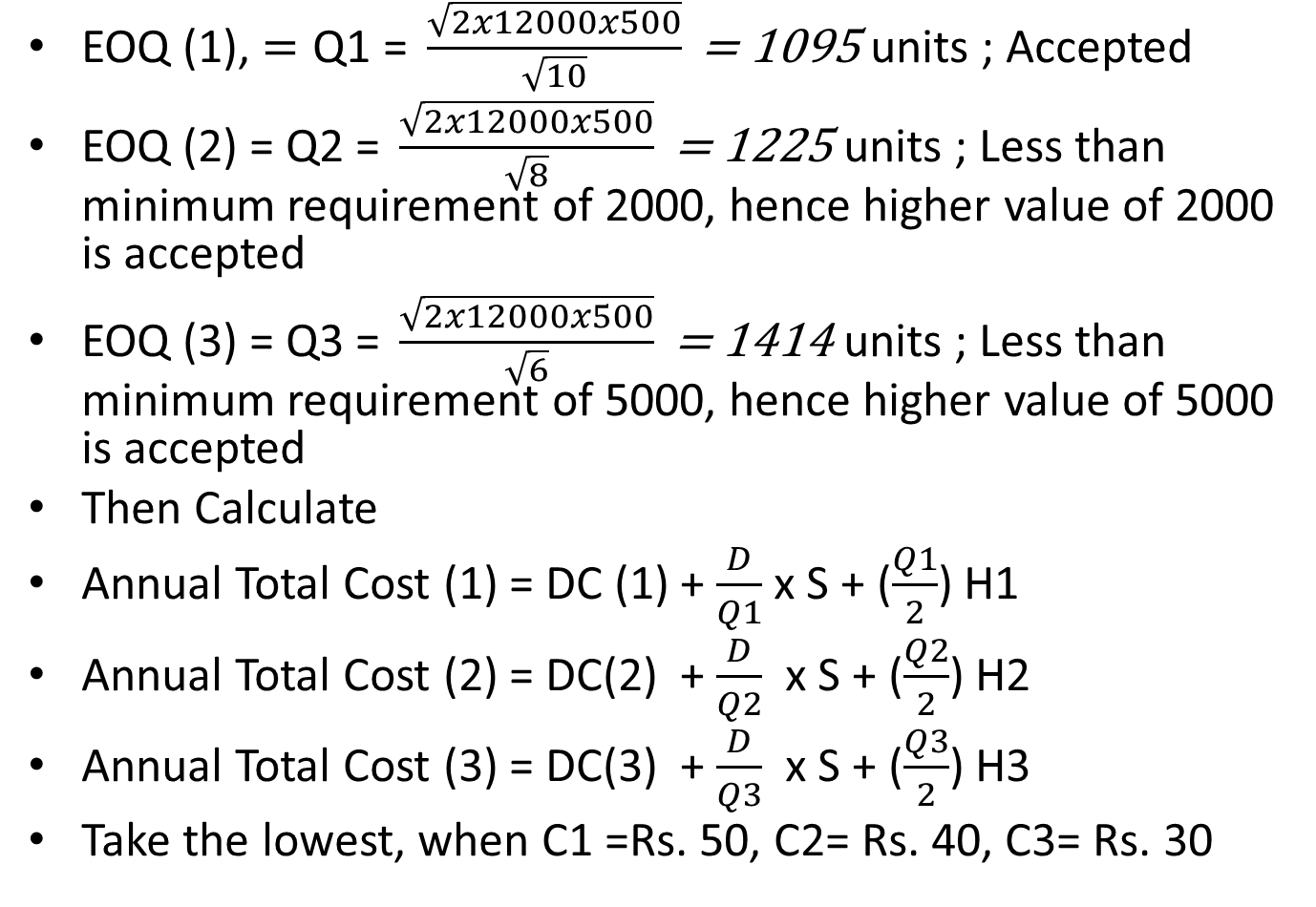
Solution
EOQ (1), $=\text{Q}\text{1 = }\frac{\sqrt{2x12000x500}}{\sqrt{10}}\text{ = 1095 }$units ; Accepted
EOQ (2) = Q2 $\text{= }\frac{\sqrt{2x12000x500}}{\sqrt{8}}\text{ = 1225 }$units ; Less than minimum requirement of 2000, hence higher value of 2000 is accepted
EOQ (3) = Q3 $\text{= }\frac{\sqrt{2x12000x500}}{\sqrt{6}}\text{ = 1414 }$units ; Less than minimum requirement of 5000, hence higher value of 5000 is accepted
Then Calculate
Annual Total Cost (1) = DC (1) + $\frac{D}{Q1}$ x S + ($\frac{Q1}{2}$) H1
Annual Total Cost (2) = DC(2) + $\frac{D}{Q2}$ x S + ($\frac{Q2}{2}$) H2
Annual Total Cost (3) = DC(3) + $\frac{D}{Q3}$ x S + ($\frac{Q3}{2}$) H3
Take the lowest, when C1 =Rs. 50, C2= Rs. 40, C3= Rs. 30

